Slide 1

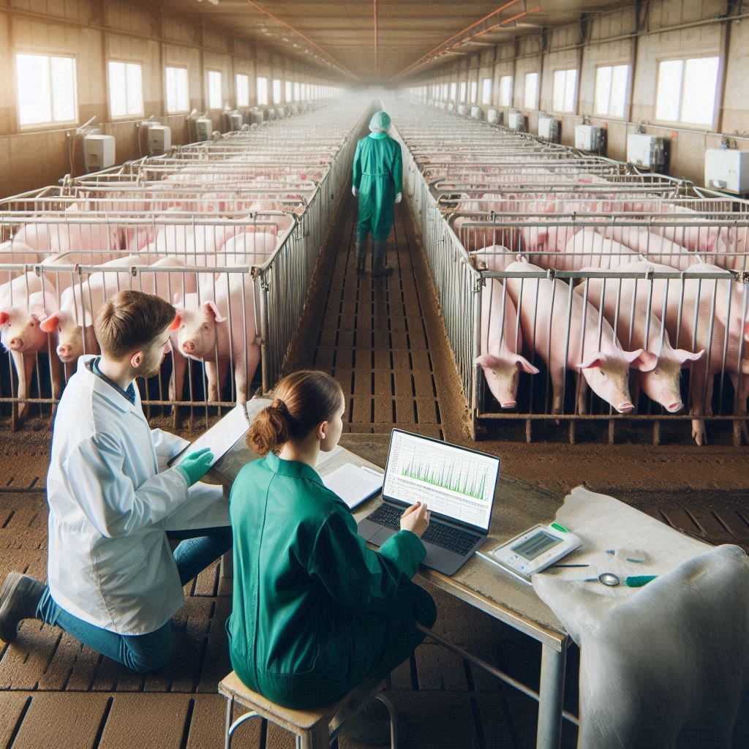
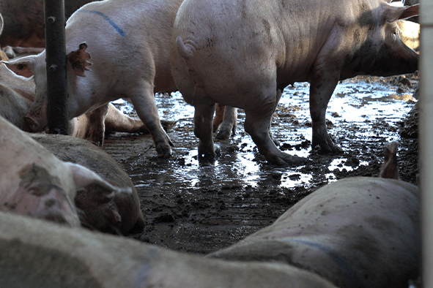


Genetic parameters of disease in growing pigs under a polymicrobial natural disease challenge
Usamah Kabuye^{1,2}, John C. S. Harding³, Michael K. Dyck⁴, Frederic Fortin⁵, Graham S. Plastow⁴, PigGen Canada⁶ and Jack C. M. Dekkers²
¹Interdepartmental Genetics and Genomics, Iowa State University, ²Department of Animal Science, Iowa State University, ³Department of Large Animal Clinical Science, University of Saskatchewan, ⁴Department of Agricultural, Food and Nutritional Science, University of Alberta, ⁵Centre de développement du porc du Québec, ⁶PigGen Canada Industry Consortium
TAP HERE TO RETURN TO KIOSK MENU
Introduction
Selection in most pig breeding programs is conducted in high-health nucleus herds, but pigs typically encounter multiple pathogens in commercial herds.
Knowledge gap of genetic parameters of disease related traits under a polymicrobial disease challenge still exists
Genetic parameters e.g., heritabilities and genetic correlations between traits are key to strategic animal breeding.
Objective
Estimate genetic parameters for treatment and mortality associated with specific diseases of growing pigs under a severe natural polymicrobial disease challenge

Slide 2

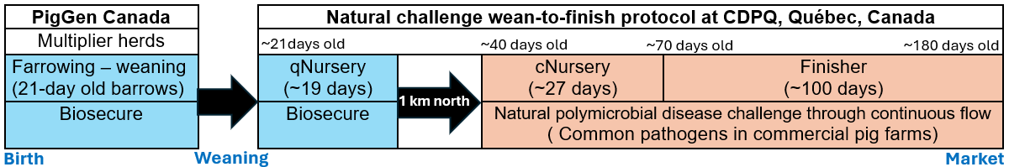
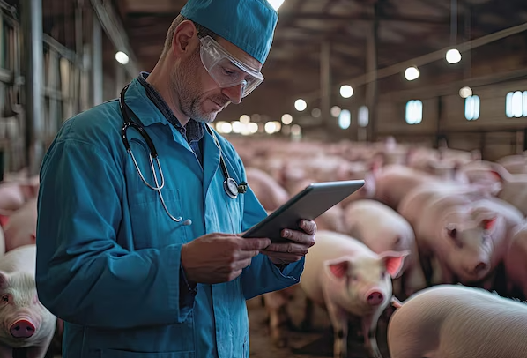
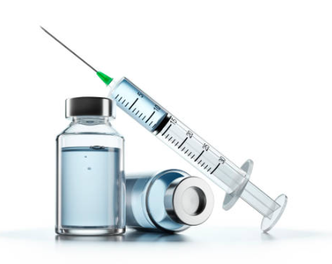
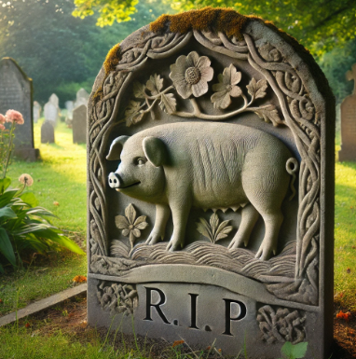
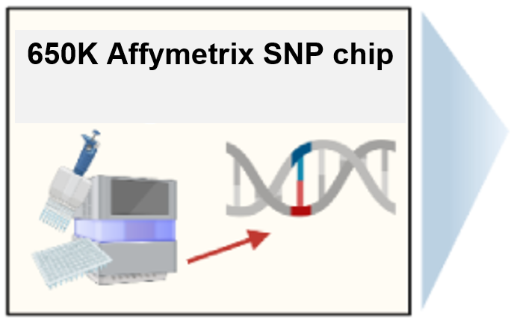
Genetic parameters of disease in growing pigs under a polymicrobial natural disease challenge
Usamah Kabuye^{1,2}, John C. S. Harding³, Michael K. Dyck⁴, Frederic Fortin⁵, Graham S. Plastow⁴, PigGen Canada⁶ and Jack C. M. Dekkers²
¹Interdepartmental Genetics and Genomics, Iowa State University, ²Department of Animal Science, Iowa State University, ³Department of Large Animal Clinical Science, University of Saskatchewan, ⁴Department of Agricultural, Food and Nutritional Science, University of Alberta, ⁵Centre de développement du porc du Québec, ⁶PigGen Canada Industry Consortium
TAP HERE TO RETURN TO KIOSK MENU
Materials and methods A three-phase natural polymicrobial disease challenge (Putz et al.,2019, Frontiers in Genetics)
Disease resilience data collection
Animals and genotyping
4,095 Y × LR barrows
66 batches (each ~60 -75 pigs)
Phenotypic data - Individual health treatments and mortality records categorized as:
Meningitis
Respiratory distress
Scours
Unthriftiness
Other viral and/or bacterial infections
Variance Component Estimation
Single trait and bivariate analyses using generalized and linear mixed models with genomic relationships using ASReml (4.2)
Model: y_{ijklm} = Batch_{i} + EntryAge_{ijklm} + Pen_{k} + Sow_{ijkl} + Pig(grm)_{ijklm} + e_{ijklm}

Slide 3
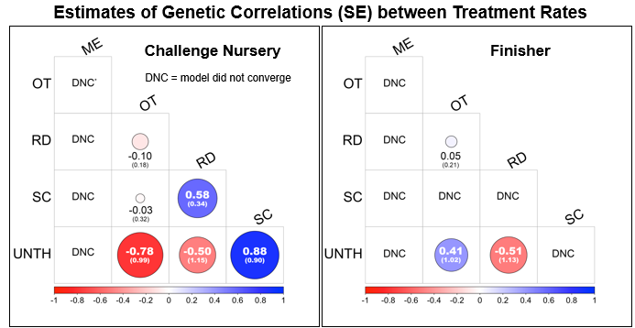
Genetic parameters of disease in growing pigs under a polymicrobial natural disease challenge
Usamah Kabuye^{1,2}, John C. S. Harding³, Michael K. Dyck⁴, Frederic Fortin⁵, Graham S. Plastow⁴, PigGen Canada⁶ and Jack C. M. Dekkers²
¹Interdepartmental Genetics and Genomics, Iowa State University, ²Department of Animal Science, Iowa State University, ³Department of Large Animal Clinical Science, University of Saskatchewan, ⁴Department of Agricultural, Food and Nutritional Science, University of Alberta, ⁵Centre de développement du porc du Québec, ⁶PigGen Canada Industry Consortium
TAP HERE TO RETURN TO KIOSK MENU

Slide 4




Genetic parameters of disease in growing pigs under a polymicrobial natural disease challenge
Usamah Kabuye^{1,2}, John C. S. Harding³, Michael K. Dyck⁴, Frederic Fortin⁵, Graham S. Plastow⁴, PigGen Canada⁶ and Jack C. M. Dekkers²
¹Interdepartmental Genetics and Genomics, Iowa State University, ²Department of Animal Science, Iowa State University, ³Department of Large Animal Clinical Science, University of Saskatchewan, ⁴Department of Agricultural, Food and Nutritional Science, University of Alberta, ⁵Centre de développement du porc du Québec, ⁶PigGen Canada Industry Consortium
TAP HERE TO RETURN TO KIOSK MENU
Key points
Respiratory distress treatment rate and mortality are substantially influenced by genetics, making it a key target for genetic selection.
Litter effects are critical in early life stages but diminish as the pigs mature.
Selection strategies to improve health treatment and mortality traits should be balanced to avoid unintended consequences.
Genetic parameters provide the roadmap for breeding programs, and this study provides valuable information to breed for disease resilience.

Slide 5
Genetic parameters of disease in growing pigs under a polymicrobial natural disease challenge
Usamah Kabuye^{1,2}, John C. S. Harding³, Michael K. Dyck⁴, Frederic Fortin⁵, Graham S. Plastow⁴, PigGen Canada⁶ and Jack C. M. Dekkers²
¹Interdepartmental Genetics and Genomics, Iowa State University, ²Department of Animal Science, Iowa State University, ³Department of Large Animal Clinical Science, University of Saskatchewan, ⁴Department of Agricultural, Food and Nutritional Science, University of Alberta, ⁵Centre de développement du porc du Québec, ⁶PigGen Canada Industry Consortium
TAP HERE TO RETURN TO KIOSK MENU
Next steps
Genome Wide Association Studies
Gene Set Enrichment Analysis
Identifying candidate genes
Manuscript preparation

Slide 6



Genetic parameters of disease in growing pigs under a polymicrobial natural disease challenge
Usamah Kabuye^{1,2}, John C. S. Harding³, Michael K. Dyck⁴, Frederic Fortin⁵, Graham S. Plastow⁴, PigGen Canada⁶ and Jack C. M. Dekkers²
¹Interdepartmental Genetics and Genomics, Iowa State University, ²Department of Animal Science, Iowa State University, ³Department of Large Animal Clinical Science, University of Saskatchewan, ⁴Department of Agricultural, Food and Nutritional Science, University of Alberta, ⁵Centre de développement du porc du Québec, ⁶PigGen Canada Industry Consortium
TAP HERE TO RETURN TO KIOSK MENU
Acknowledgements
Major Professor & PI
Dr. Jack Dekkers
POSC:
Dr. Jack Dekkers
Dr. Juan Pedro Steibel
Dr. Austin Putz
Dr. Daniel Linhares
Dr. Chong Wang
Co-authors:
John Harding
Michael Dyck
Frederic Fortin
Graham Plastow
PigGen Canada
Jack Dekkers
Funding from Genome Canada, Genome Alberta, Genome Prairie, PigGen Canada, USDA NIFA (2017-67007-26144), and the National Pork Board Survivability Project

